Slide 1
MTH302 Probability and Statistics
Lecture #0

Slide 2

Course details
LTP – 3 0 0 [Three lectures/week]
Text Book
FUNDAMENTALS OF MATHEMATICAL STATISTICS by S.C.GUPTA AND
V.K.KAPOOR, SULTAN CHAND & SONS, 2nd Edition, (2007)
Reference Books
PROBABILITY STATISTICS AND RANDAM PROCESSES by T VEERARAJAN, MC
GRAW HILL, 3rd Edition, (2011)

Slide 3
Course Assessment Model
Marks break up*
Attendance 5
CA (Two best out of three tasks) 25
MTE 20
ETE 50
Total 100

Slide 4
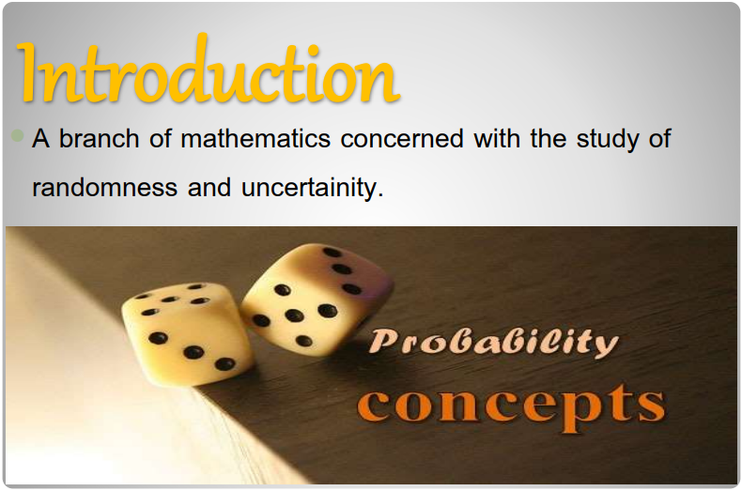

Slide 5
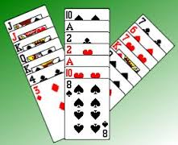
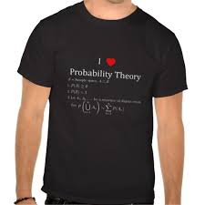
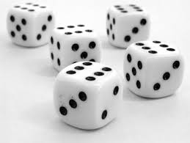

Slide 6

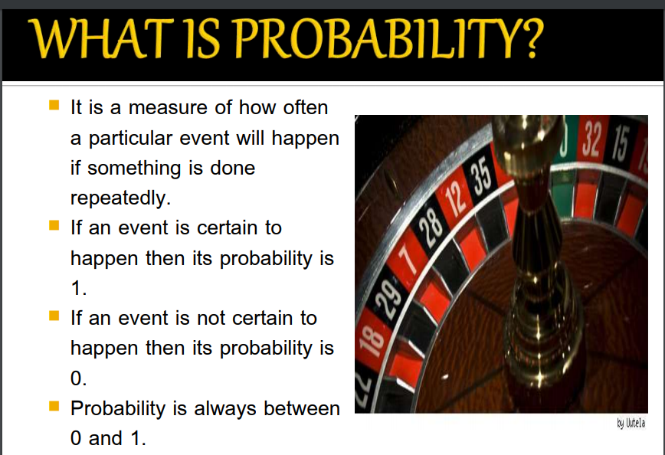

Slide 7
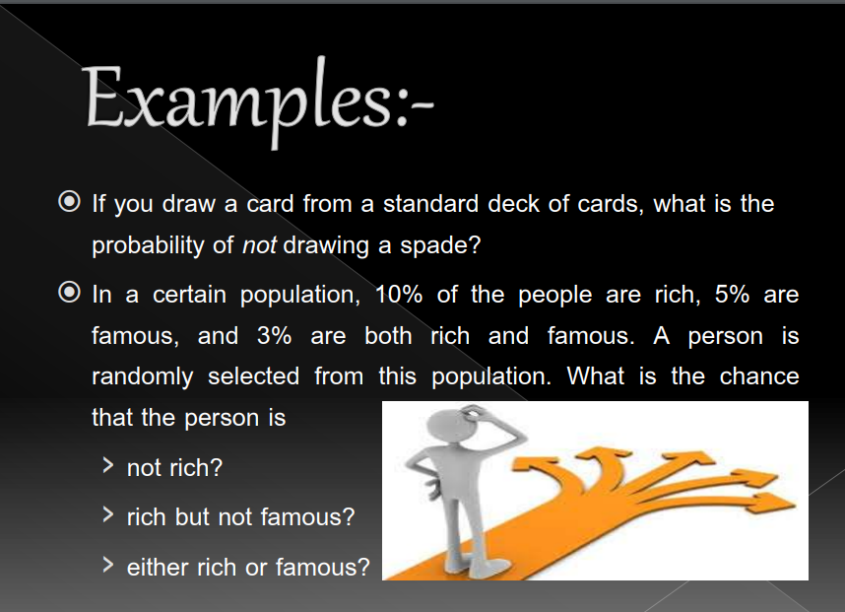
Did you check the weather forecast?
Did you decide to go through the drive through lane vs walk in?
We are constantly creating hypotheses, making predictions, testing, and analyzing.
Our lives are full of probabilities!
Statistics is related to probability because much of the data we use when determining probable outcomes comes from our understanding of statistics.

Slide 8

The course contents
Unit 1 : Basics of probability
Sample Space and Events
Probability of an Event
Rules of probability
Independent events
Conditional Probability

Slide 9
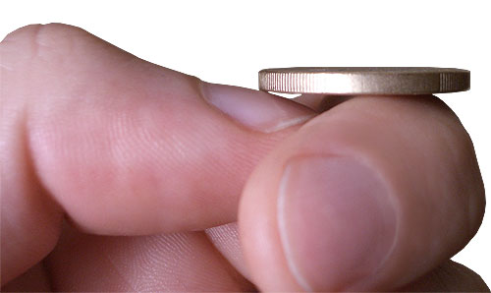

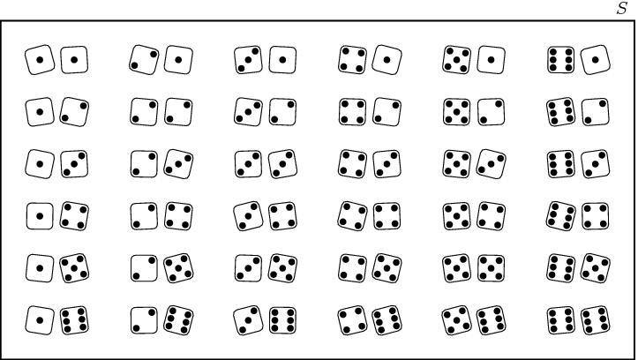


Slide 10
Unit 2 : Random variable and its characterization
Discrete and Continuous random variable
Cumulative distribution function
Expectations
Mean
Variance
Moment
Moment generating function

Slide 11
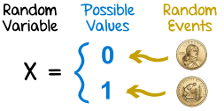

Slide 12
Two Types of Random Variables
A discrete random variable can assume a countable number of values.
Number of steps to the top of the Eiffel Tower*
A continuous random variable can assume any value along a given interval of a number line.
The time a tourist stays at the top
once s/he gets there
*Believe it or not, the answer ranges from 1,652 to 1,789. See Great Buildings

Slide 13


Two Types of Random Variables
Discrete random variables
Number of sales
Number of calls
Shares of stock
People in line
Mistakes per page
Continuous random variables
Length
Depth
Volume
Time
Weight

Slide 14

Unit 3: Probability distributions
Binomial Distribution
Poisson Distribution
Normal Distribution

Slide 15
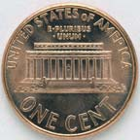
The Binomial Distribution
A Binomial Random Variable
n identical trials
Two outcomes: Success or Failure
P(S) = p; P(F) = q = 1 – p
Trials are independent
x is the number of S’s in n trials
Flip a coin 3 times
Outcomes are Heads or Tails
P(H) = .5; P(F) = 1-.5 = .5
A head on flip i doesn’t change P(H) of flip i + 1

Slide 16
The Binomial Distribution
Results of 3 flips | Probability | Combined | Summary
HHH | (p)(p)(p) | p³ | (1)p³q⁰
HHT | (p)(p)(q) | p²q
HTH | (p)(q)(p) | p²q | (3)p²q¹
THH | (q)(p)(p) | p²q
HTT | (p)(q)(q) | pq²
THT | (q)(p)(q) | pq² | (3)p¹q²
TTH | (q)(q)(p) | pq²
TTT | (q)(q)(q) | q³ | (1)p⁰q³

Slide 17
The Binomial Distribution
Say 40% of the class is female.
What is the probability that 6 of the first 10 students walking in will be female?

Slide 18
The Poisson Distribution
● = mean number of occurrences in the given unit of time, area, volume, etc.
e = 2.71828….
µ = 
² = 

Slide 19

The Poisson Distribution
Say in a given stream there are an average of 3 striped trout per 100 yards. What is the probability of seeing 5 striped trout in the next 100 yards, assuming a Poisson distribution?

Slide 20
Unit 4: Point Estimation
Definition
Unbiased estimators
Consistent Estimators
Sufficient Estimator
MLE ( Method of Maximum Likelihood )

Slide 21


Slide 22
Unit 5: Testing of Hypothesis
Population and Sample
Types of Error
Test of Goodness of a Fit
Student t-test
Z-test
F-test

Slide 23
Unit 6: Correlation and Regression
Bi-variate data
Scatter plots
Linear correlation
Regression
Fitting the line and curve
Properties of correlation coefficient.

Slide 24
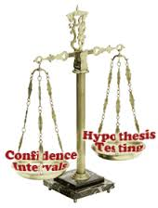

Slide 25
The course outcomes…
The course MTH302: Probability and Statistics will…
Recall the basic principles of probability and Bayes theorem.
Visualize and use the concept of random variables to find the probability of an event.
Use of some important distributions to find the probabilities.
Discuss the method to find out the estimator and properties of estimator.
Illustrate the concept of correlation, regression, hypothesis testing and their applications.

Slide 26
Thank You

